Slide 1

Flask App In-Class Exercise
A semester’s worth of material in 30 minutes or less for you to copy-pasta
CS411 Spring 23
Peter B. Golbus

Slide 2

Web Server Gateway Interface?

Slide 3
What is Flask?
Flask is a Python micro web framework
It generates http responses and nothing else

Slide 4
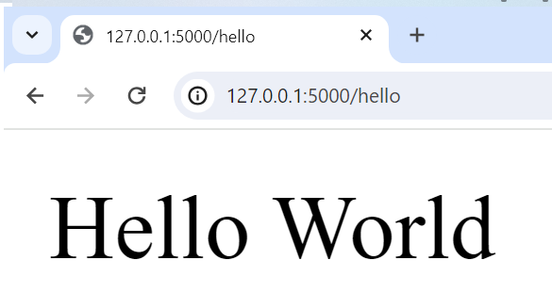
Anatomy of hello world
route
from flask import Flask
app = Flask(__name__)
@app.route('/hello')
def main():
app.logger.info("Hello world")
return "Hello World", 200
if __name__ == "__main__":
# to run me from the command line: <flask --app main run> or <python app.py>
#
app.run(host='0.0.0.0', port=5000, debug=True)
app
host

Slide 5
Layout of a flask app
webapp/
| webapp/
| | __init__.py
| | utils.py
| | logger.py
| | webapp_model.py
| static
| | css
| | | style.css
| | javascript
| | | webappView.js
| | images / assets / whatever
| templates
| | index.html
| app.py
| requirements.txt
| requirements.lock

Slide 6
Requirements.*
Top level requirements for a human
requirements.txt
All requirements for deployment
requirements.lock
Flask==2.2.3
click==8.1.3
Flask==2.2.3
importlib-metadata==6.0.0
itsdangerous==2.1.2
Jinja2==3.1.2
MarkupSafe==2.1.2
mysql-connector-python==8.0.32
protobuf==3.20.3
Werkzeug==2.2.3
zipp==3.15.0

Slide 7
Virtualenvs
DON’T INSTALL DEPENDENCIES INTO YOUR SYSTEM PYTHON ENVIRONMENT
python -m venv /path/to/new/virtual/environment
source /path/to/new/virtual/environment/bin/activate
pip install –r requirements.lock
When you are done
deactivate

Slide 8
But just do this
Setup python, pip, virtualenv and virtualwrapper, with zsh on a new machine (github.com)

Slide 9
Installing requirements with pip
Install requirements
pip install flask
Generate lock file
pip freeze > requirements.lock
Install from file
pip install –r requirements.lock

Slide 10
Injecting HTML with Jinja2 templates
{{ variables }},
{% if conditionals %}
{% for loops in lists %}
Not really a frontend / backend. This is all backend

Slide 11
Allowance app
Webview in front of a db table
SQLite is a rdbms that stores small databases in flat text files
Constants stored in .env file
People have the weirdest hobbies

Slide 12
Getting fancy with jquery
Load index and update w/ results from API calls
True frontend / backend decoupling
Example: concentration

Slide 13
Minesweeper and Mastermind
I have implemented
The model logic for Minesweeper and Mastermind
Basic frontend versions
True decoupled versions
I have provided
Model logic
Templates and a stubbed out app for frontend version
Templates and a stubbed out app view for decoupled version
Full solutions

